Slide 1
Junk-Broker System
Anthony Redamonti Michael Peña Clayton Colson Kenneth Chalupa

Slide 2
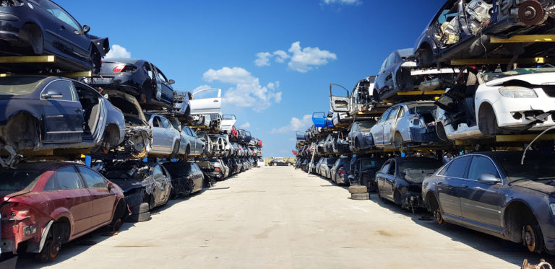
What is a Junkyard?
Yards that contain large quantities of scrap metal
Many specialize in storing nonfunctional or damaged vehicles, such as cars, trucks, SUV’s, motorcycles, boats, ATV’s, and other commercial types
Functional vehicular parts are sold at a discounted rate

Slide 3
What is the Junk-Broker System?
An interactive transaction-based application tailored toward the junkyard industry
Offers an easier method of buying and selling vehicular parts through an organized interactive application

Slide 4
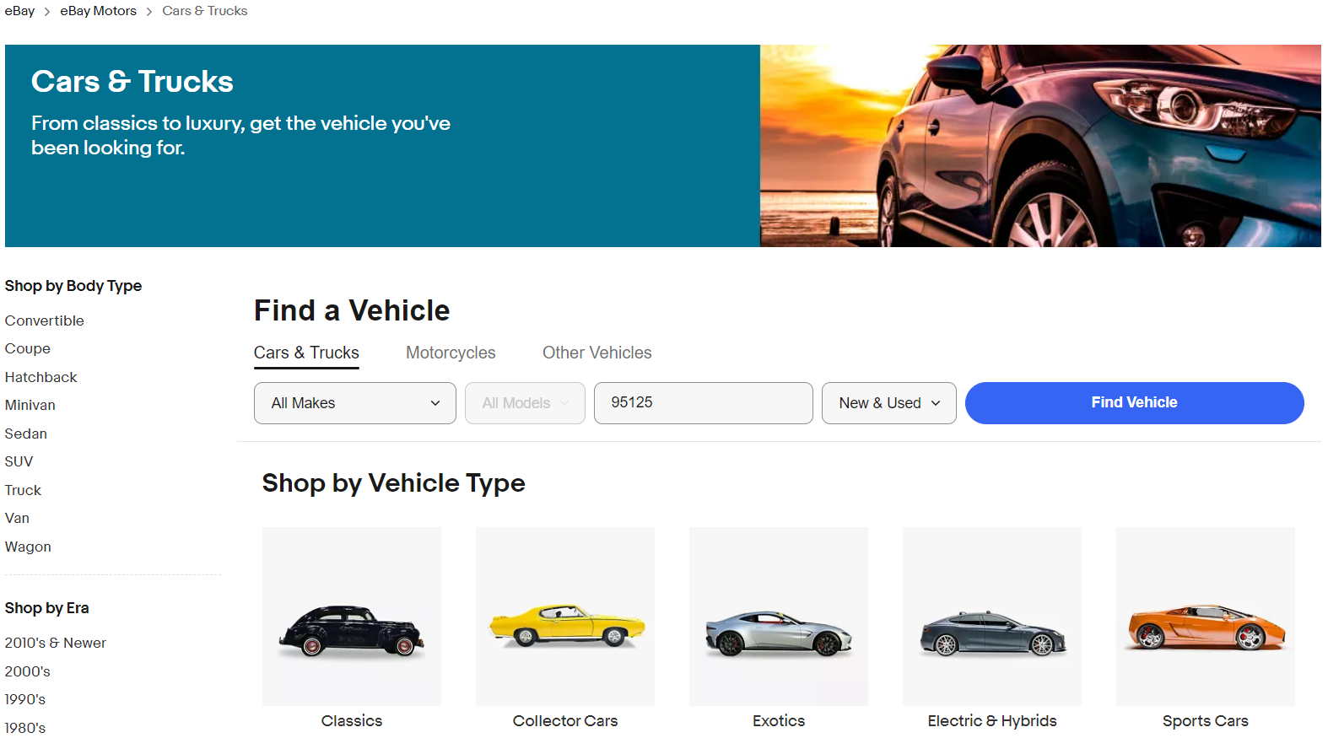
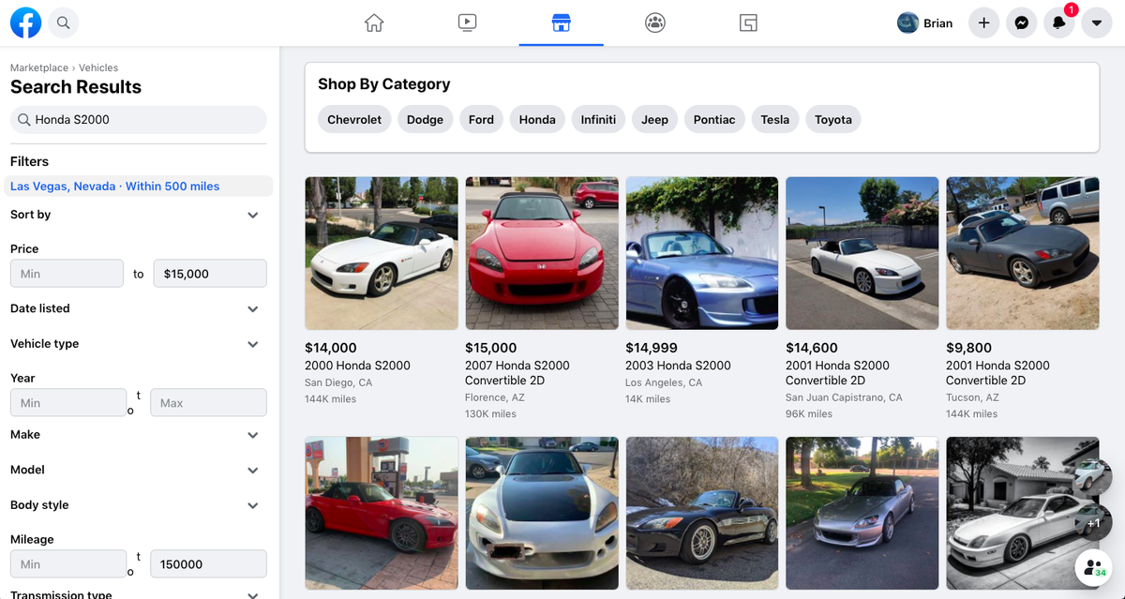
Similar Systems
Facebook Marketplace
Ebay

Slide 5
System Architecture
Transaction-Processing Information System
Processes read/write requests to the Junk-Broker database
Web-based system: user interface implemented using web browser
Requests are asynchronous events
Front-end interacts with API client to process user events
API client interacts with database to fulfill request

Slide 6
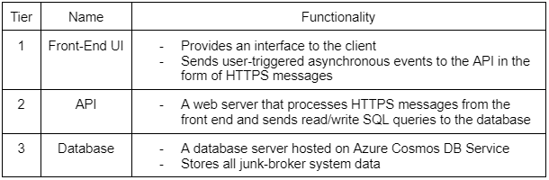
System Architecture

Slide 7
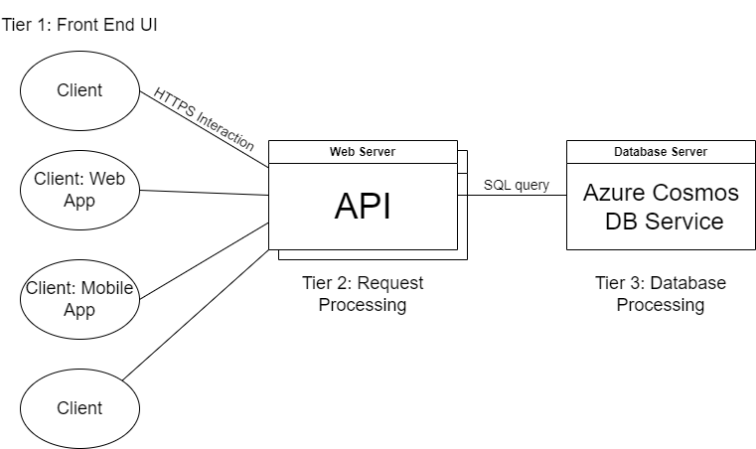

Slide 8
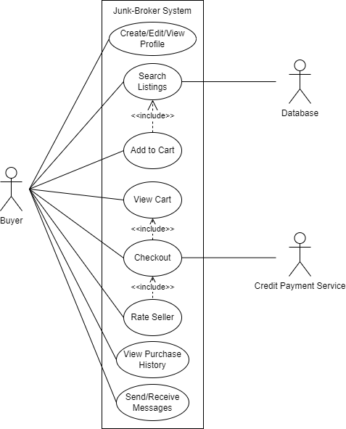
Use-Case Diagram: The Buyer

Slide 9
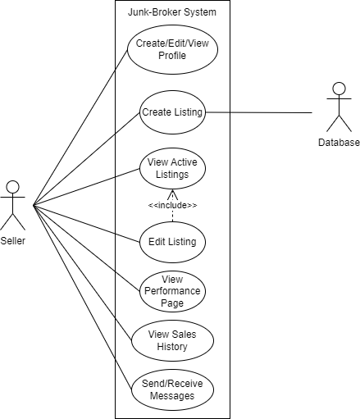
Use-Case Diagram: The Seller

Slide 10
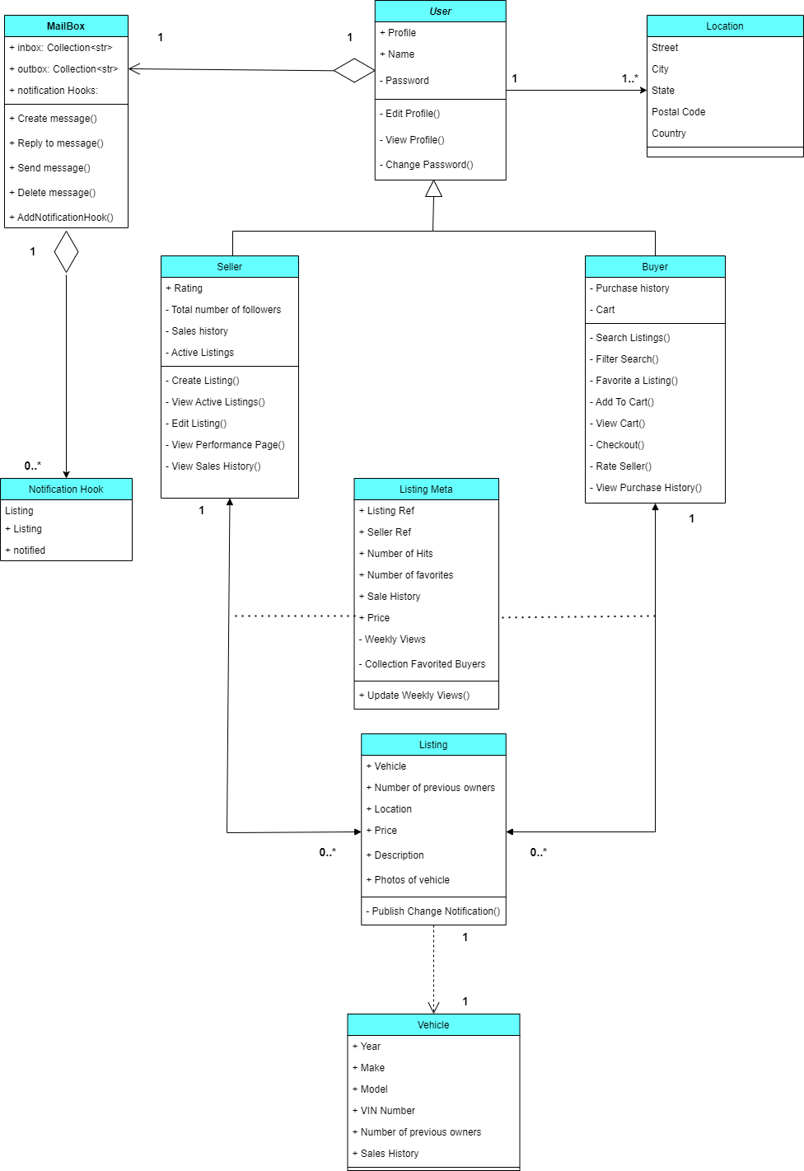
Class Diagram
Buyer and Seller classes inherit from User class
Seller creates listings
Seller writes to database
Buyer reads from database
Buyer and seller aggregate a mailbox to exchange messages

Slide 11
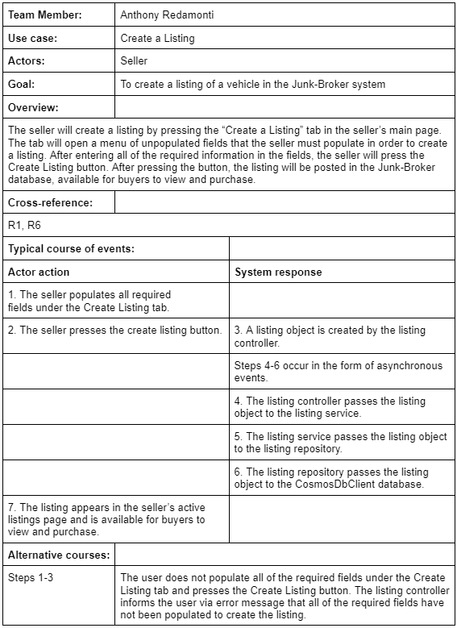
Use-Case Detailed Descriptions: Create a Listing

Slide 12
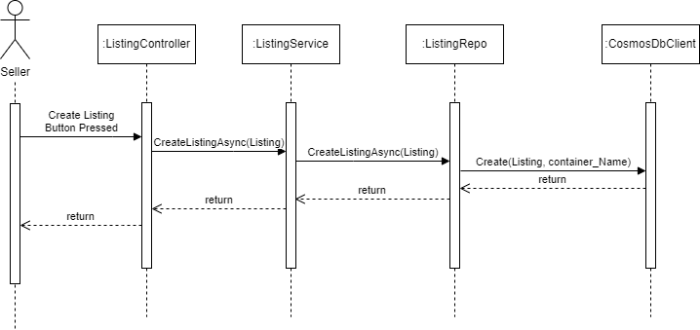
Sequence Diagram: Create a Listing

Slide 13
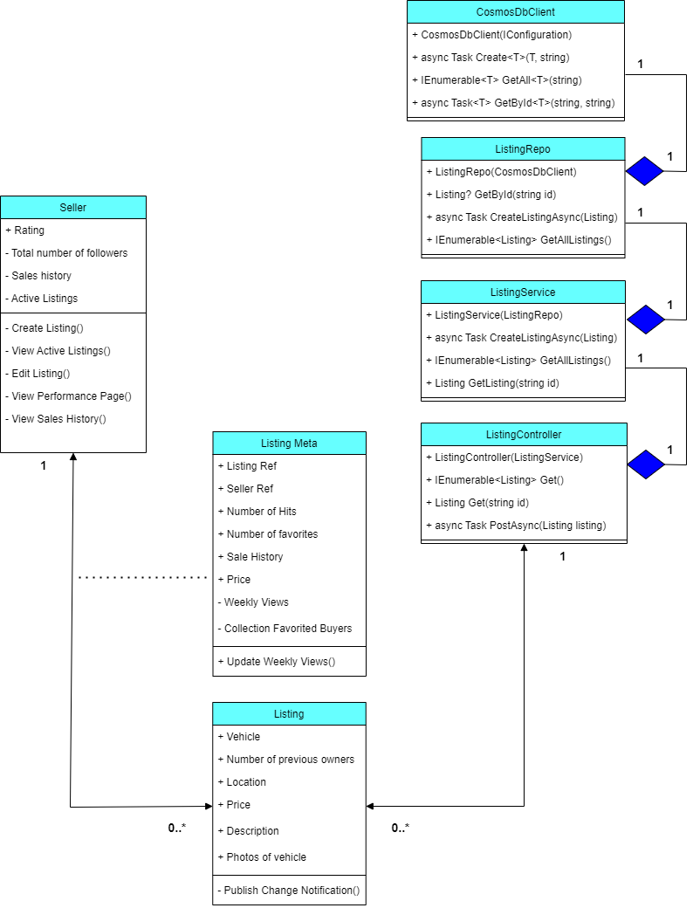
Class Diagram: Create a Listing

Slide 14
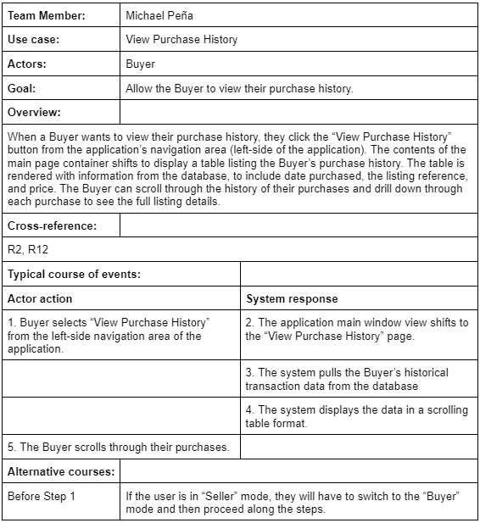
Use-Case Detailed Descriptions: View Purchase History

Slide 15
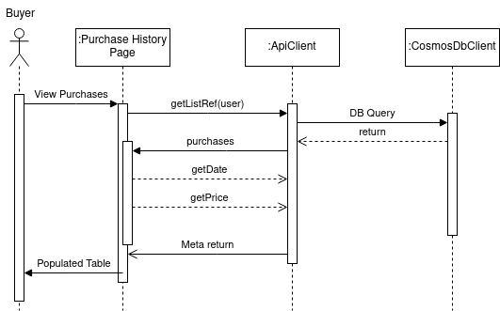
Sequence Diagram: View Purchase History

Slide 16
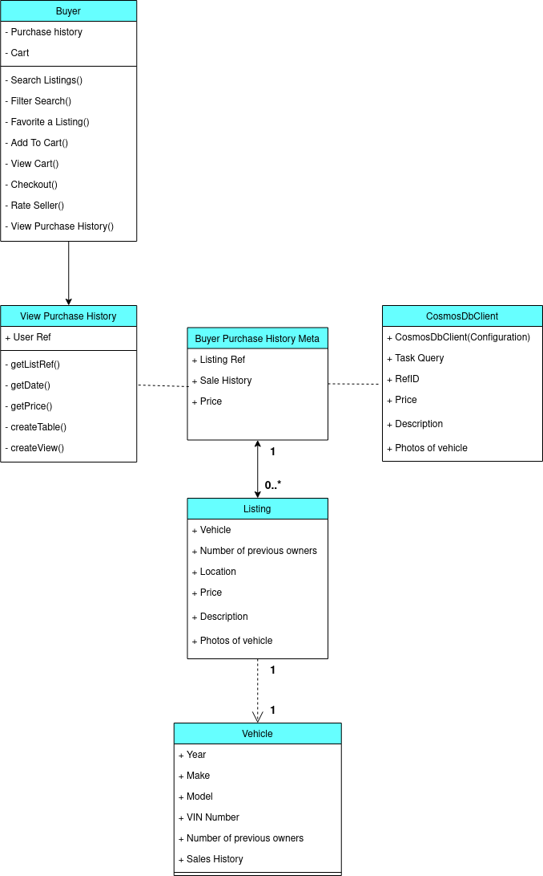
Class Diagram: View Purchase History

Slide 17
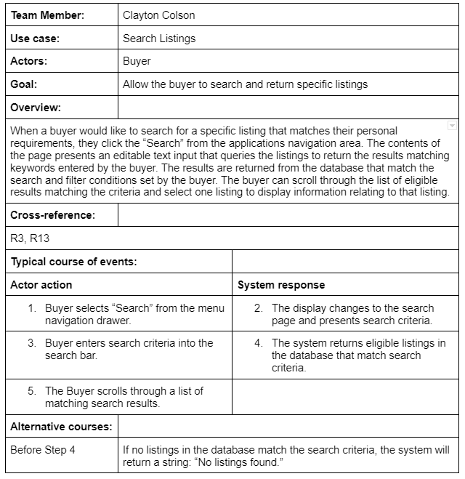
Use-Case Detailed Descriptions: Search Listings

Slide 18
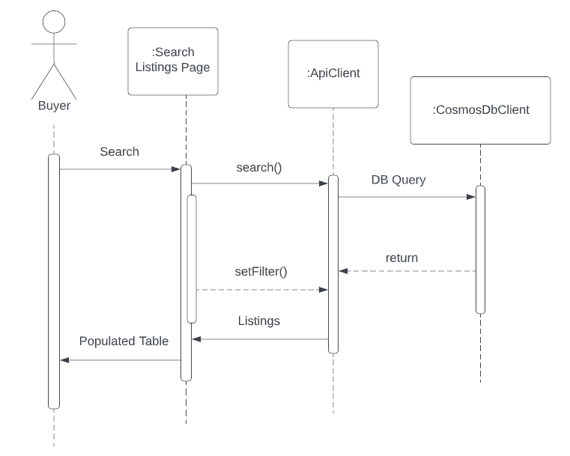
Sequence Diagram: Search Listings

Slide 19
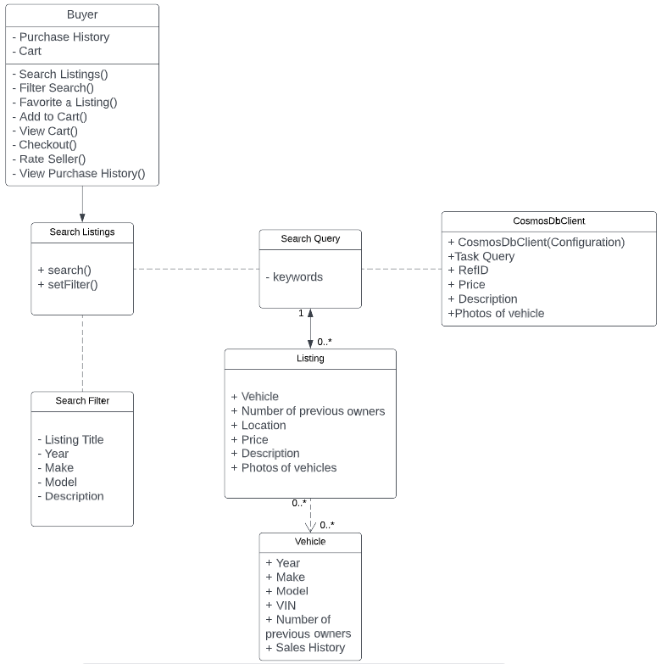
Class Diagram: Search Listings

Slide 20
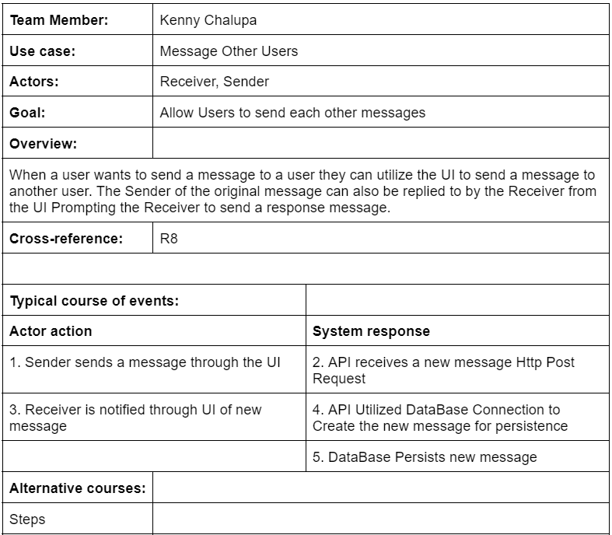
Use-Case Detailed Descriptions: Message Other Users

Slide 21
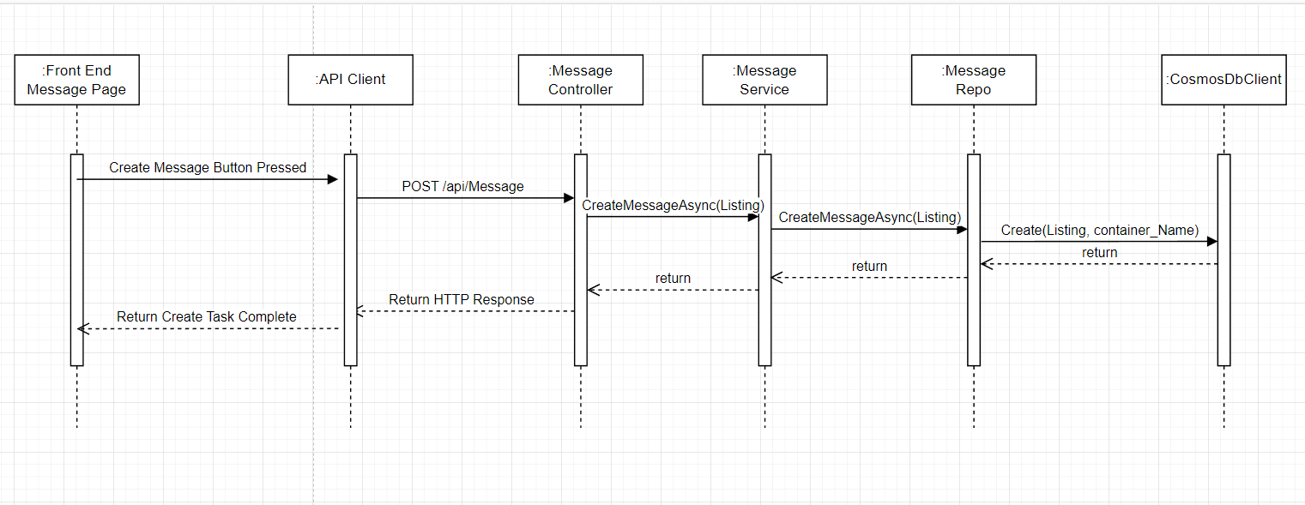
Sequence Diagram: Message Other Users

Slide 22
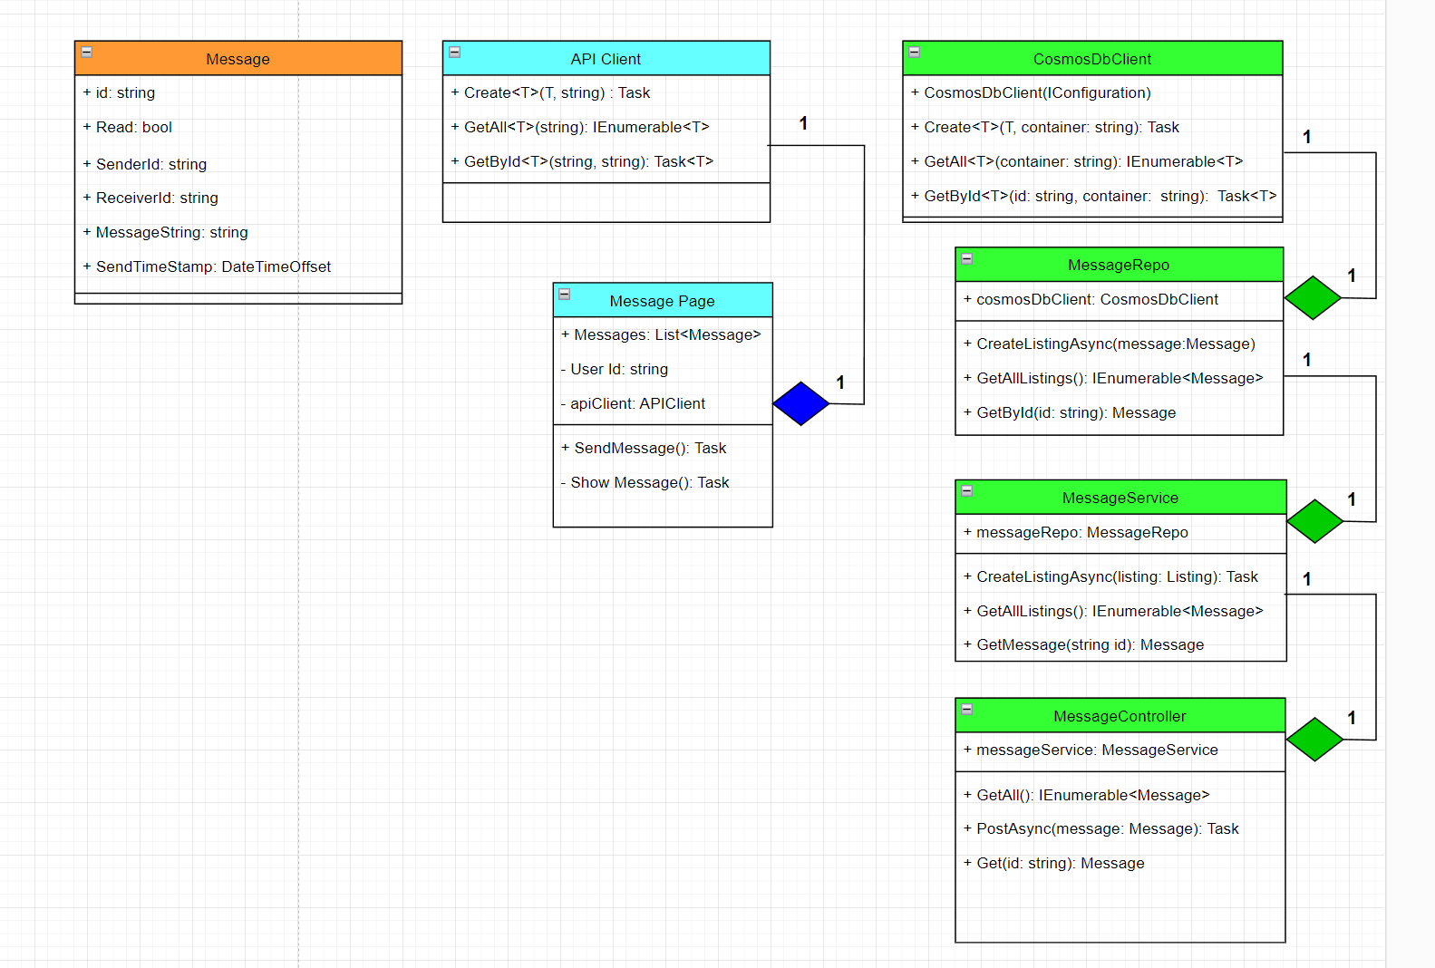
Class Diagram: Message Other Users

Slide 23
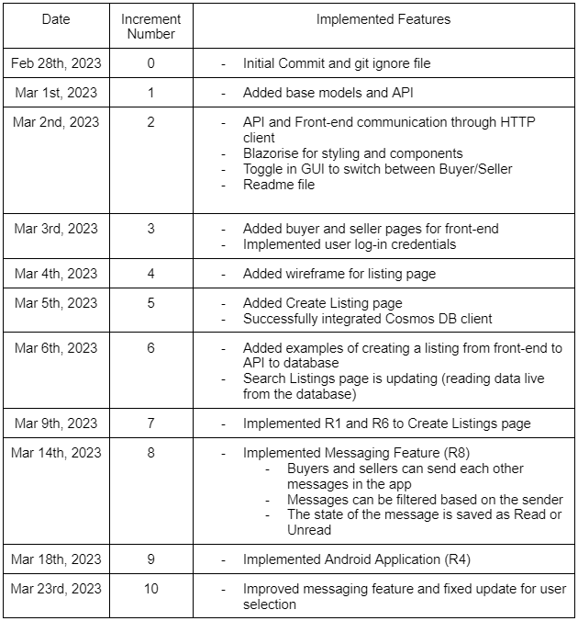
System Evolution
Future feature developments:
View listings and performance feature on the Seller Page (R7)
Transaction Features: Buyer’s Cart, Checkout Feature (R14)
Favorite Listings Feature on Buyer Page (R11)

Slide 24
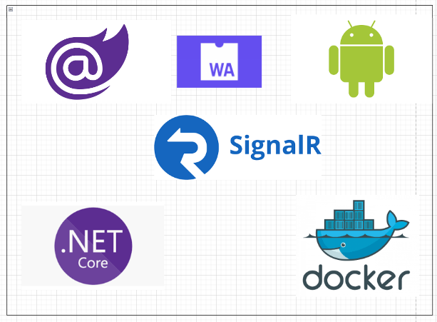
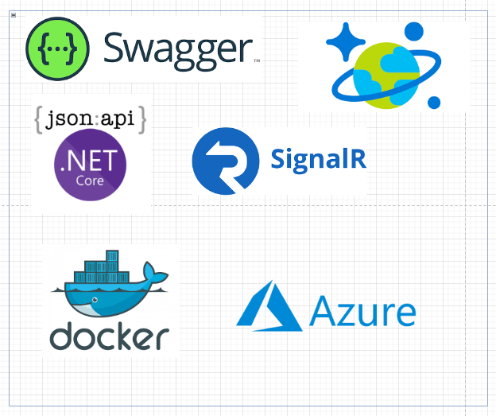
Front End and Back End Tech Stack

Slide 25

Thank you!
Link to repository: https://github.com/kchalupa72/JunkBroker

Slide 26
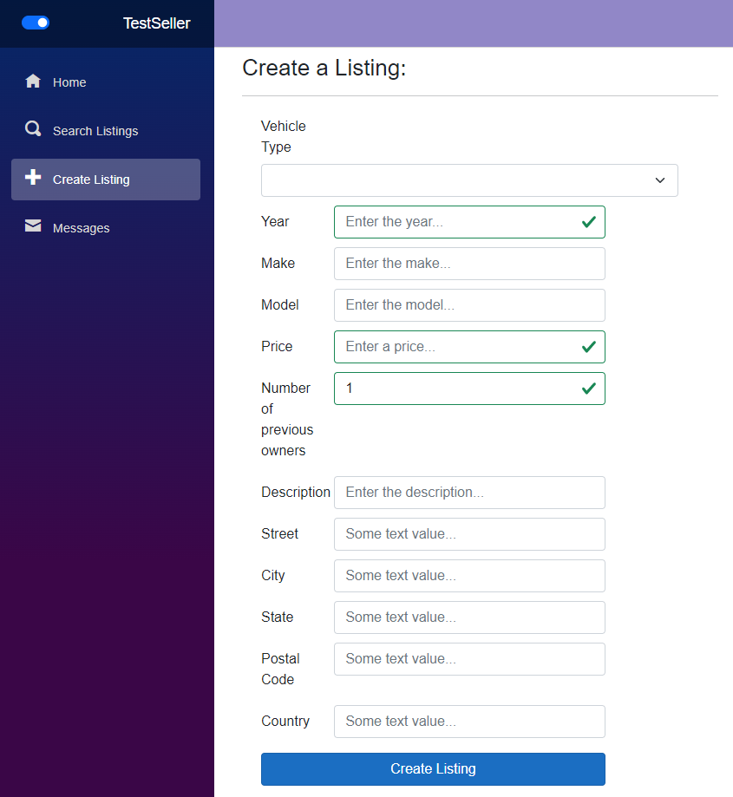
Create Listing Implementation
Front-End
https://junkbrokerfrontend20230318181957.azurewebsites.net/

Slide 27
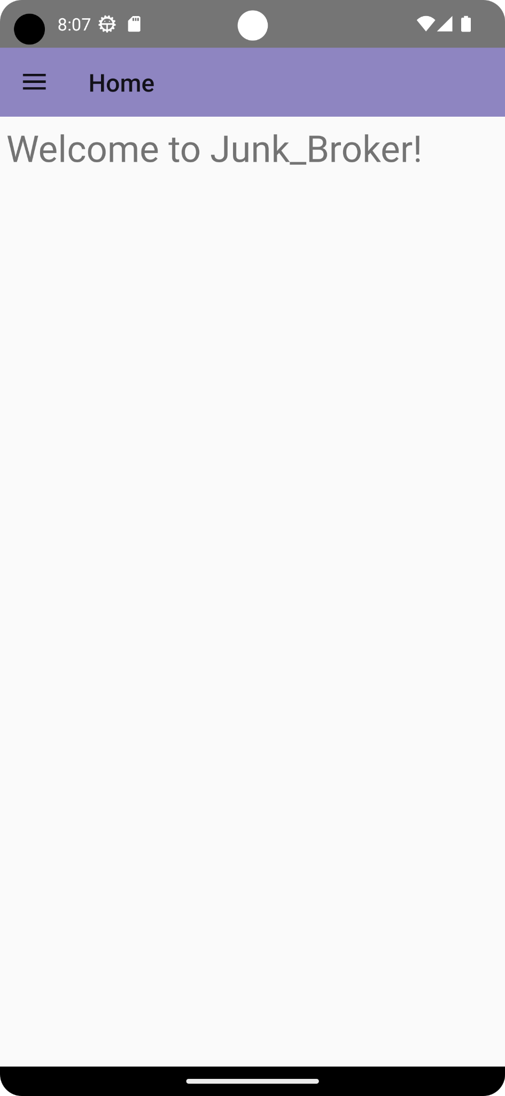

Visuals: Mobile App Mockup

